Slide 1
6th grade
GEOMETRY
REMEEZA.M
II M.Ed GENERAL
21PED005

Slide 2

POINT

Slide 3


Slide 4
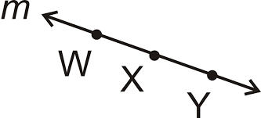
LINE

Slide 5
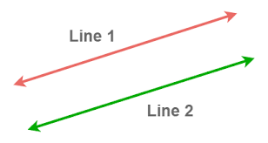
Parallel lines

Slide 6
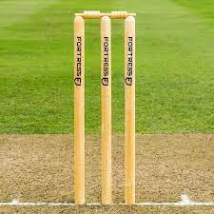
Parallel lines example

Slide 7
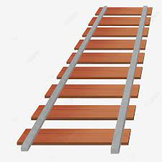
Railway track

Slide 8

Zebra crossing

Slide 9
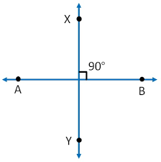
Perpendicular line

Slide 10
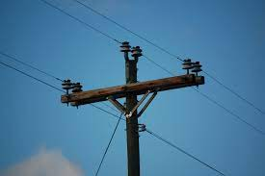
Example

Slide 11
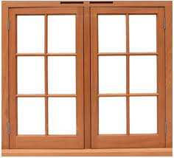
Window grill

Slide 12
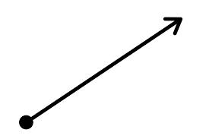
RAY

Slide 13
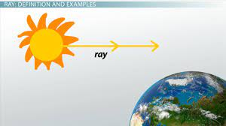
Example

Slide 14
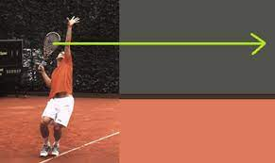

Slide 15
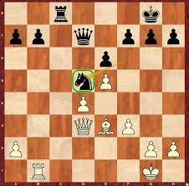
Square

Slide 16

Rectangle

Slide 17
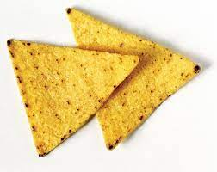
Triangle

Slide 18
ANGLES
Acute angle
Obtuse angle
Right angle
Straight angle
Reflex angle
Full rotation

Slide 19
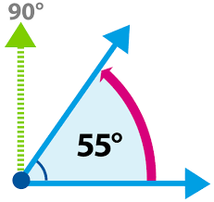
Acute angle
Less than 90

Slide 20
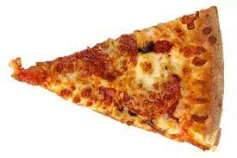

Acute angle example

Slide 21
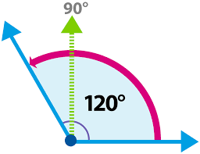
Obtuse angle More than 90

Slide 22
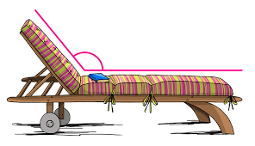
Obtuse angle example

Slide 23

?

Slide 24
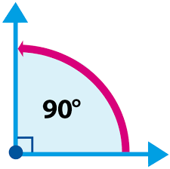
Right angle Equal to 90

Slide 25
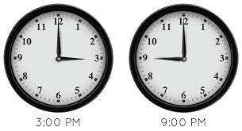
Examples

Slide 26
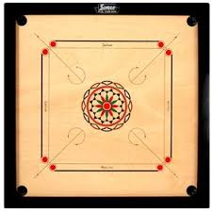
???

Slide 27

Straight angle

Slide 28
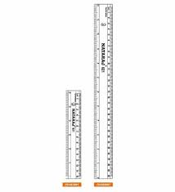
Example

Slide 29
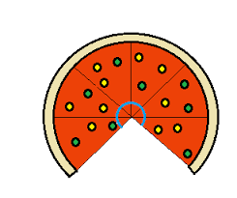
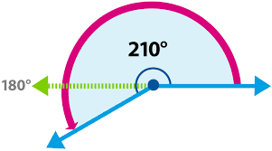
Reflex angle More than 180

Slide 30
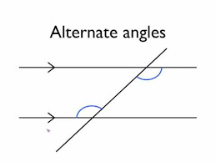
ALTERNATE ANGLES

Slide 31
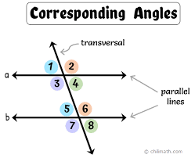

Slide 32
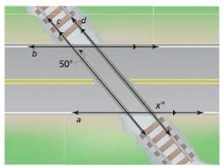
EXAMPLE

Slide 33
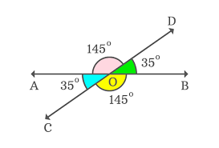
VERTICALLY OPPOSITE ANGLE

Slide 34
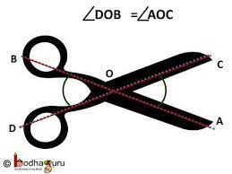
EXAMPLE

Slide 35
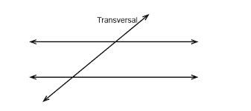
TRANSVERSAL

Slide 36
EXAMPLE

Slide 37
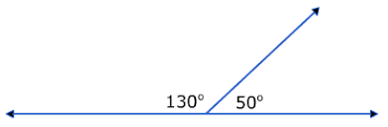
Supplementary angles sum = 180

Slide 38
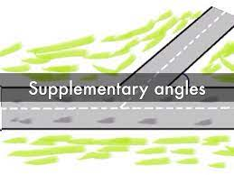
Example

Slide 39
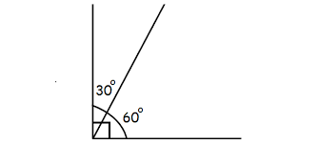
Complementary angle sum=90

Slide 40

Example

Slide 41


circle

Slide 42
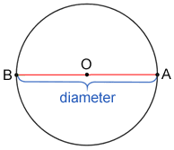
Diameter of a circle

Slide 43
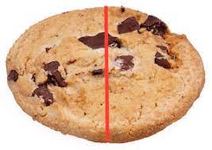
Example

Slide 44
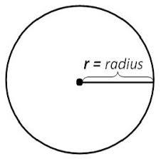
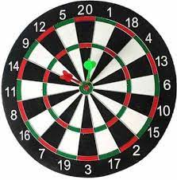
RADIUS

Slide 45
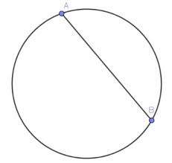

Chord

Slide 46

Concentric circles

Slide 47

Example

Slide 48
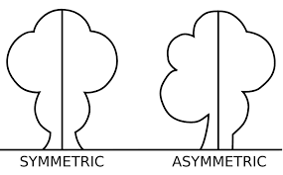
Symmetry

Slide 49

Example

Slide 50
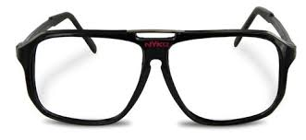
Symmetry

Slide 51
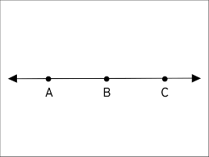
Collinear

Slide 52
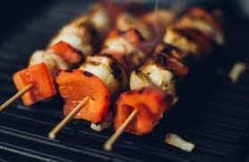
Example

Slide 53
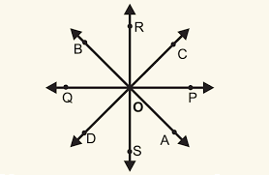
Concurrent

Slide 54
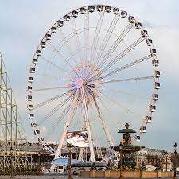
Example

Slide 55


Slide 56



